Slide 1
Creating 3D Volume Data using Unstructured Grids with Anchor Points
Jacob Howell
Notes:
Hey look that's me

Slide 2
Overview
Irregular/Unstructured grids
Irregular grids - Landscapes/environments for games, mesh generation, etc
Irregular grids - Townscaper by Oskar Stålberg
Project aims to demonstrate their use in filling a 3D space
Notes:
Irregular or unstructured grids are grids where each grid cell does not necessarily have the same size or shape and requires a connectivity list to traverse
You see these kinds of grids used on more complex 3d landscapes and environments, mesh generation, etc
One standout use of irregular grids is Townscaper by Oskar Stalberg. Townscaper is a citybuilder that uses irregular grids as the basis for the building grid. The original version of this project started as a term project that was heavily inspired by Townscaper
This project aims to demonstrate that irregular grids can not only be used in 3 dimensions but more specifically to fill a 3D space

Slide 3
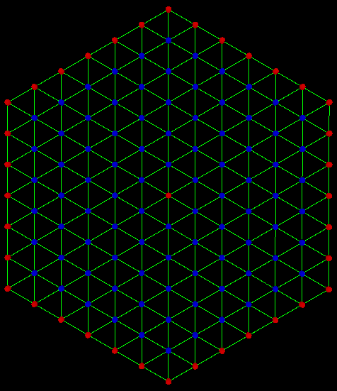
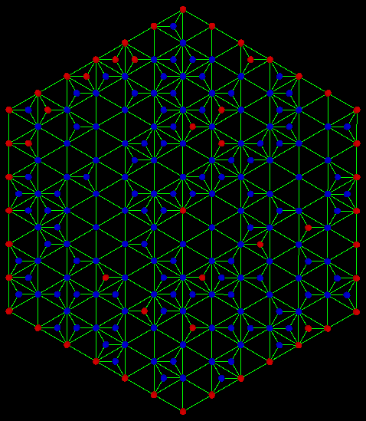
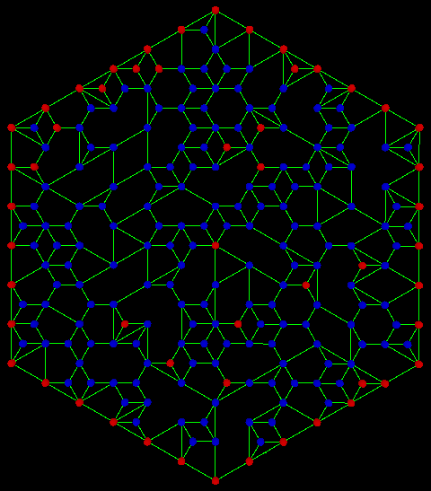
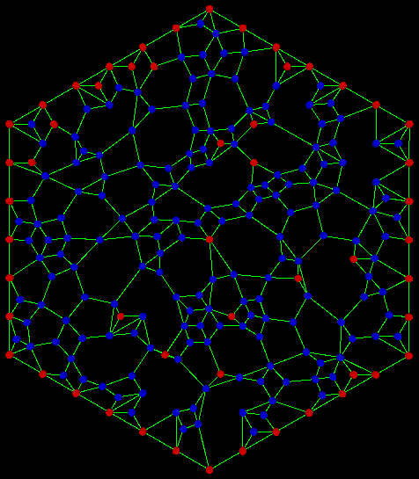
General Algorithm
1) Create Standard Grid
2) Subdividing the Grid
Create a new grid node in the middle of an existing grid cell
3) Edge Removal
Shuffle list of grid nodes
If node as more edges than minimum count & node connected by targeted edge has more than minimum count, remove the edge
4) Relax/Rebalancing
Move each node(not outer edge nodes) so that the interior grid space is evenly filled
Repeat multiple times
Notes:
The general algorithm for creating the grid is as follows:
Create a standard grid – 1st image
Subdivide the grid by placing new nodes in existing grid cells – 2nd image
Remove edges from nodes if the node has enough connections – 3rd image
Rebalance the grid – 4th image(after multiple applications)
This can be done in a variety of methods, my preferred method is Laplacian smoothing
This does need to be repeated multiple times

Slide 4
2D Version
Created for a term project
Follows the general algorithm
Includes immovable points to prevent grid collapse
Notes:
Initially created as a term project in Dr Semwal’s Computational Geometry class
Follows the general algorithm from the previous slide, with the slight addition of immovable points to prevent the grid from collapsing in on itself

Slide 5
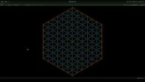
Notes:
Short demo from the term project
Vid link: https://youtu.be/4X8p0310VVM
Mention that the list of points is shuffled before the edge removal step

Slide 6
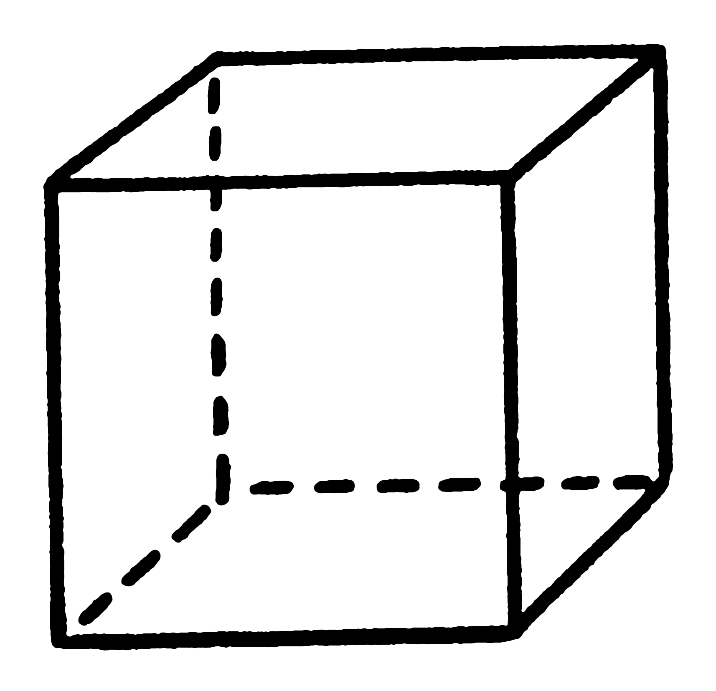
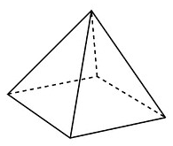
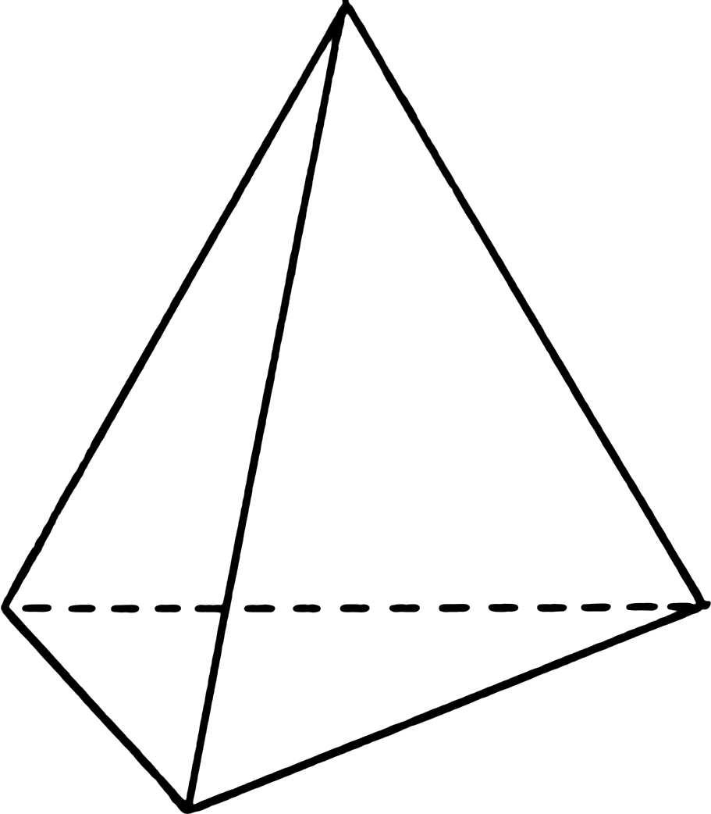
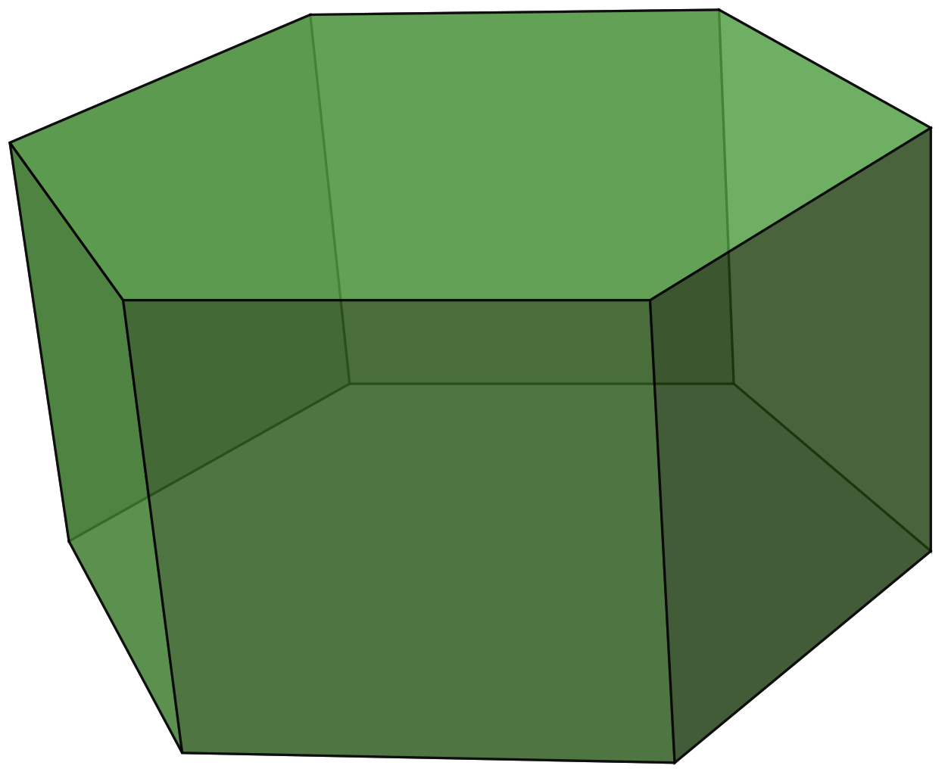
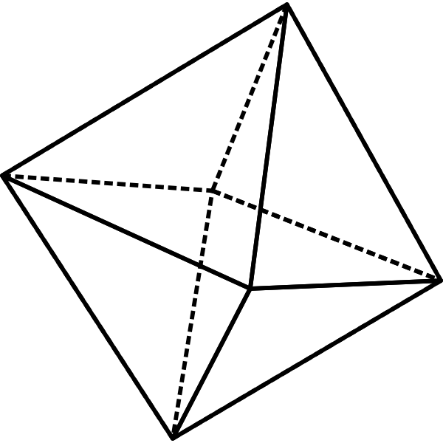
Base 3D Version
2D version in 3 dimensions
Intended to test for any issues that might arise from the added dimension
Specifically how close the volume description is to the original 3D shape
5 shapes will be used for testing:
Cube
Pyramid
Tetrahedron
Hexagonal Prism
Octahedron
Notes:
The base 3D version is the 2D version with an extra dimension and is intended to test for any issues that might arise from the added dimension
5 shapes will be used for testing:
Cube – simplest shape to test with
Pyramid – test what happens when the grid comes to a point
Tetrahedron – test what happens when the grid comes to a more severe point as well as what happens if the number of sides is reduced
Hexagonal prism – test what happens when the number of sides is increased
Octahedron – test what happens when the number of points is increased significantly

Slide 7
3D Anchor Version
Similar to the Base 3D version with main difference
Instead of standard 3D shape, anchor points will serve as the outer extremes used to build the grid
Allows for the generated grid to fill the defined space as well as allowing for a less rigidly defined grid shape
Notes:
The 3D anchor version is similar to the base 3D version with the major difference of instead of a standard geometric shape, anchor points with serve as the outer extremes that the grid is built from
This would allow the grid to fill the space defined by the anchor points as well as letting the grid be less rigidly defined

